Slide 1
NEW CASTLE COMMUNITY MEETING
PRESENTATION
A discussion about emergency preparedeness and responce in case of a railroad incident
Nov 6th 2023 6:00-7:30pm
New Castle Elementary

Slide 2
PRESENTERS
Norfolk Southern
Lydia McPherson & Scott Gould
Goodwill Fire Co
Fire Chief: David Majewski Jr
New Castle City Police
Police Chief: Richard McCabe
Delaware Department of Natural Rescouces
Matt Higgins (Emergency Response Chief)
New Castle County Emergency Management
Chris Hodgden (Emergency Planner)
Delaware Emergency Management Agency
Director: AJ Schall

Slide 3
Response to a Rail Incident
911 Call and Dispatch Procedures
Initial Reponse of Local Emergency Responders
Hazardous Material Team Actions and Capabilities
Public Protective Actions
Investigation Clean up, After Actions, Training, Exercises

Slide 4
911 Call and Dispatch Procedures
Initial 911 Call; can come from general public or train company
Fire Priority Dispatch System assures the calltakers get all the informaton needed
Location of Incident
CAD system has all train tracks and crossings listed to get precise location

Slide 5
911 Call and Dispatch Procedures
Incident is Dispatched to Local Responders from the 911 Center
911 Center attempts to obtain additional information and make notification as they can:
Dispatched via radio and text/computer pages
Initial dispatch would be:
Level 4 response:
4 Engines
2 Ladders
Rescue
New Castle County and Kent County Haz-Mat Decon Teams
DNREC Emergency Response Team
Local Law Enforcement Also Notified
Depending on additional information obtained notifications would then be made administrative staff and emergency management.
Make contact with railroad to stop additional trains and have company leadership respond.
Get additional information on what is being transported, train car information, labels or placards, (AskRail *will be covered later), scale of derailment, leaking contents?.
Providing additional resources as requested by incident commander.

Slide 6
Initial Response
Although every incident will be unique, these are some of the main objectives during the initial response
Establish command,
Determine the nature and scope of the Incident,
Determine the presence of immediate life hazards,
Determine the number and status of any passengers,
Determine the presence of hazardous materials,
Determine the need for additional units and access points
Make contact with train engineer or conductor.
Attempt to identify hazardous materials that have spilled or leaked
Determine initial isolation distances and public protective actions if necessary

Slide 7
DNREC - Emergency Response
All DNREC On-Scene Coordinators are trained as Hazardous Materials Specialist and trained for rail-car response.
DNREC Response for rail car incidents is governed by the provisions and procedures for hazardous material responses found within the State of Delaware’s Hazardous Substance Incident Contingency Plan (aka the SERT Plan) **more on this later**
NIMS/ICS DNREC would be in charge of the Hazardous Materials Branch and a key part of Unified Command and decision making process

Slide 8
DNREC - Emergency Response
Air Monitoring
Plume Modeling
DNREC has equipment that can monitor the air at and near the incident site. This equipment can be deployed by personnel or placed at remote locations and monitored via remote telemetry.
Able to use real time information to monitor and track any releases into the air using advanced plume modeling systems.
Cleanup and protection
DNREC will work with the Responsible Party to ensure any cleanup needed is completed as soon as possible. Cleanup standards are established that are protective of both human health and the environment.

Slide 9
Public Protective Actions
Shelter-in-place VS Evacuation
Shelter-in-Place: “Stay Put and Seal Off Your Space”
means to stay put in a safe and sturdy building and seal off the space you are in from any outside air to make a safe place where you are.
Used for a short term incident where evacuation could be more dangerous than staying.
Evacuate” means to get away from the danger.
It means the area or building is not safe for you stay in. You must leave and go to a shelter or other place outside of the area so you may stay as safe as possible until the emergency is under control.
Listen to the radio, television, or your mobile news app, or follow instructions in text alerts to find the nearest shelter and go there.

Slide 10
Public Protective Actions
Shelter-in-place VS Evacuation
Decision is made by incident commander with input from all the expects.
The initial action for protection is based on the potential of the incident
As more information is received actions can be upgraded or downgrade based on actual hazards.
In the event of a evacuation you will first be sent to a “reception center” to gather needs and serve as a temporary location until opening of a long-term shelter if needed.

Slide 11
But How Do I Know?

Slide 12
Planning, Training, Exercising, Repeat!

Slide 13
Planning, Training, Exercising, Repeat!

Slide 15
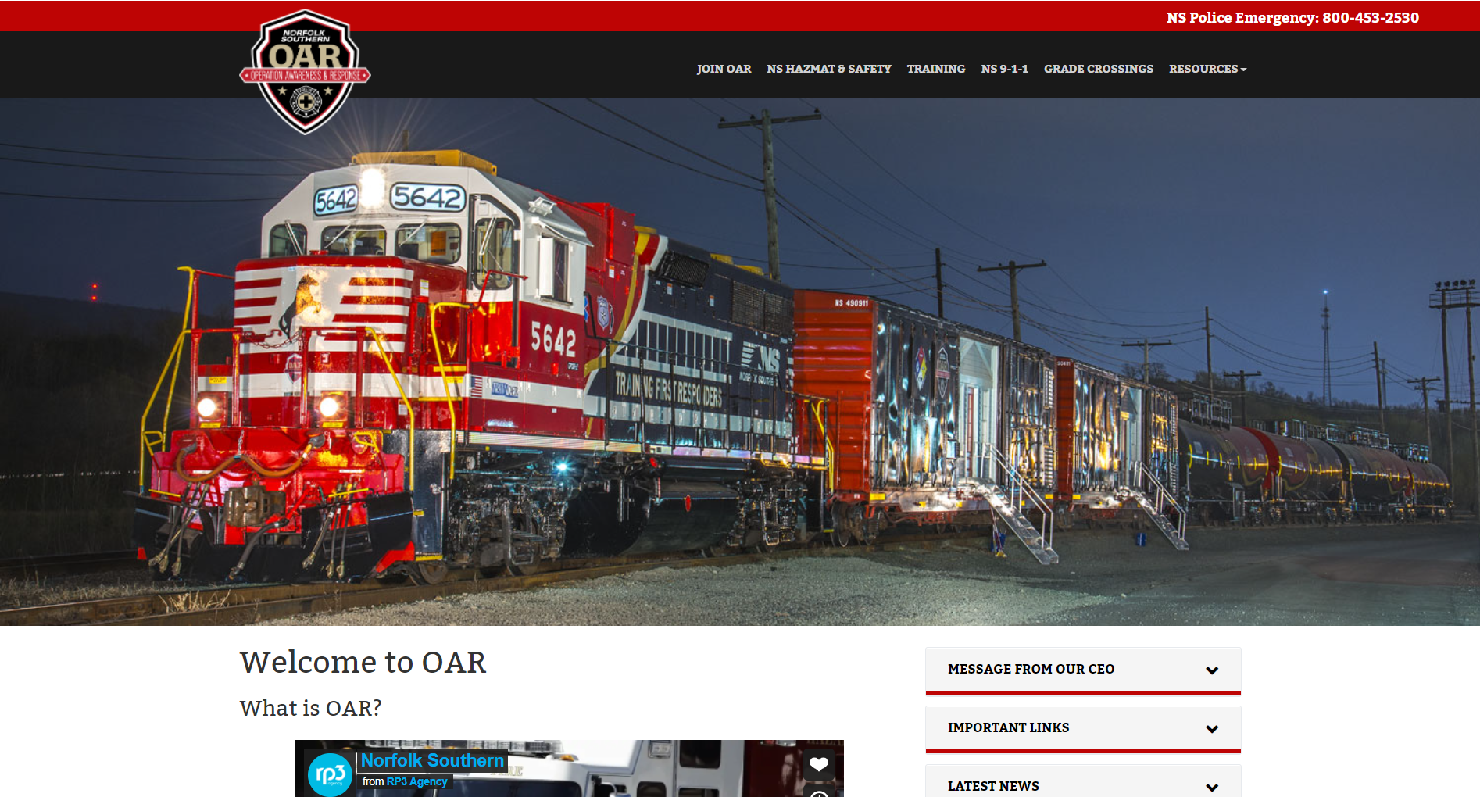
www.joinnsoar.com

Slide 16
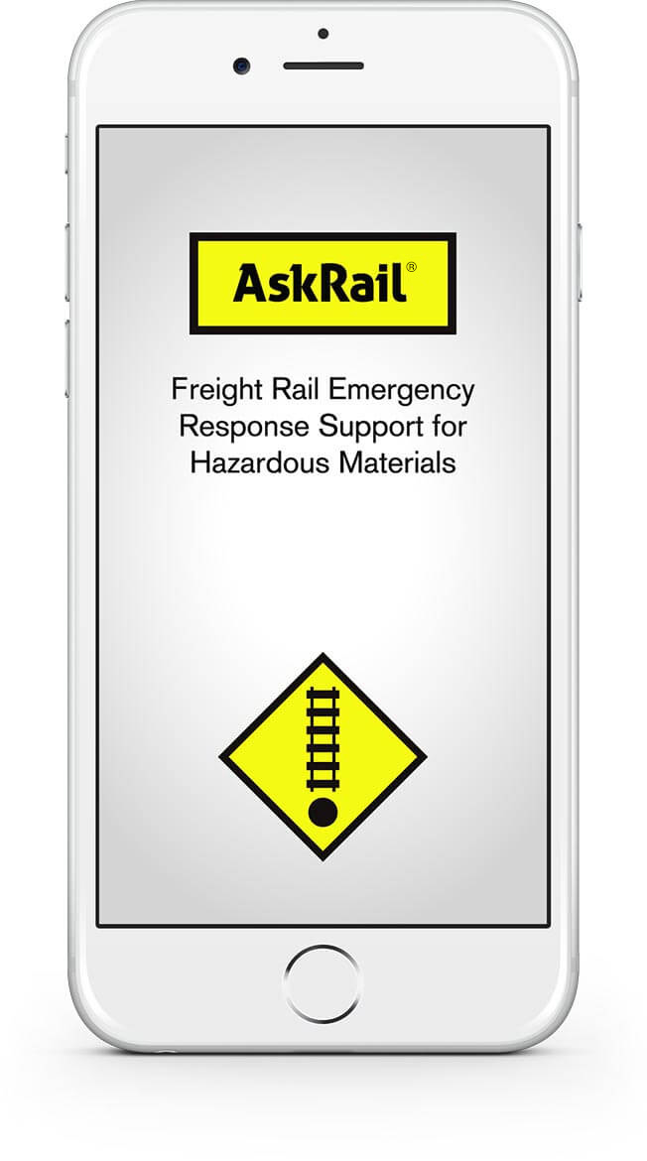
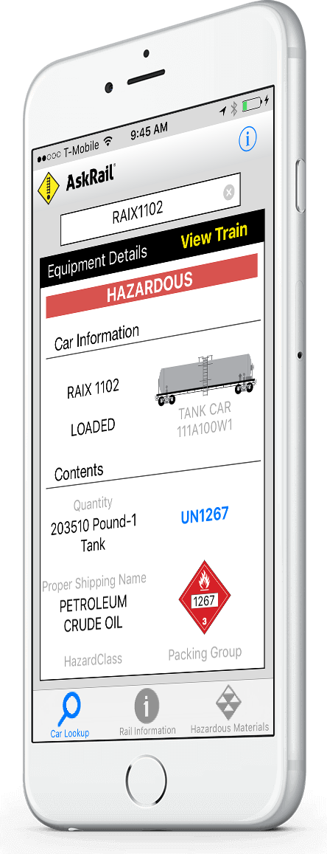
AskRail App

Slide 17
AskRail App
Equipment Details
Car Information
Contents (Basic Hazmat Description)
Railroad Contact Information
Not Shipper Contact Information
Tap Placard or UN Number

Slide 18
AskRail App
View Train
Searched Car is in a Train
Option to View Entire Train
Hazmat Cars Highlighted Red

Slide 19
